Slide 1


COURSE WORK 2 CST3340: BUSINESS INTELLIGENCE Name: Atiqahmed Hanifmohmed Rathod MSIS: M00836913
Case Study: Hospital patients Analysis

Slide 2
Hospital Data Overview
Data includes: Age, Gender, Blood Pressure, Heart Rate, Diagnosis, Treatment Type, Length of Stay, Insurance Type, Recovery Status.
Objective: To analyze the impact of treatment types and recovery statuses across different demographics.
Total Records: 851 patients
Total Columns: 11 unique features
Data Type: Cleaned & Categorical
Focus: Patient diagnosis, treatments, vitals, and recovery
Tools Used: Weka for pattern mining, Tableau for visualization

Slide 3
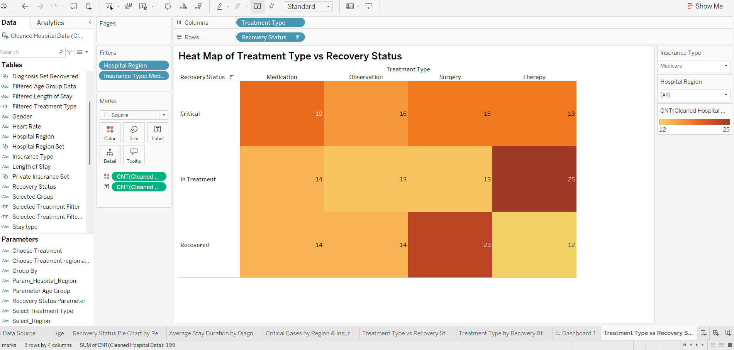
Tableau for Visualization

Slide 4
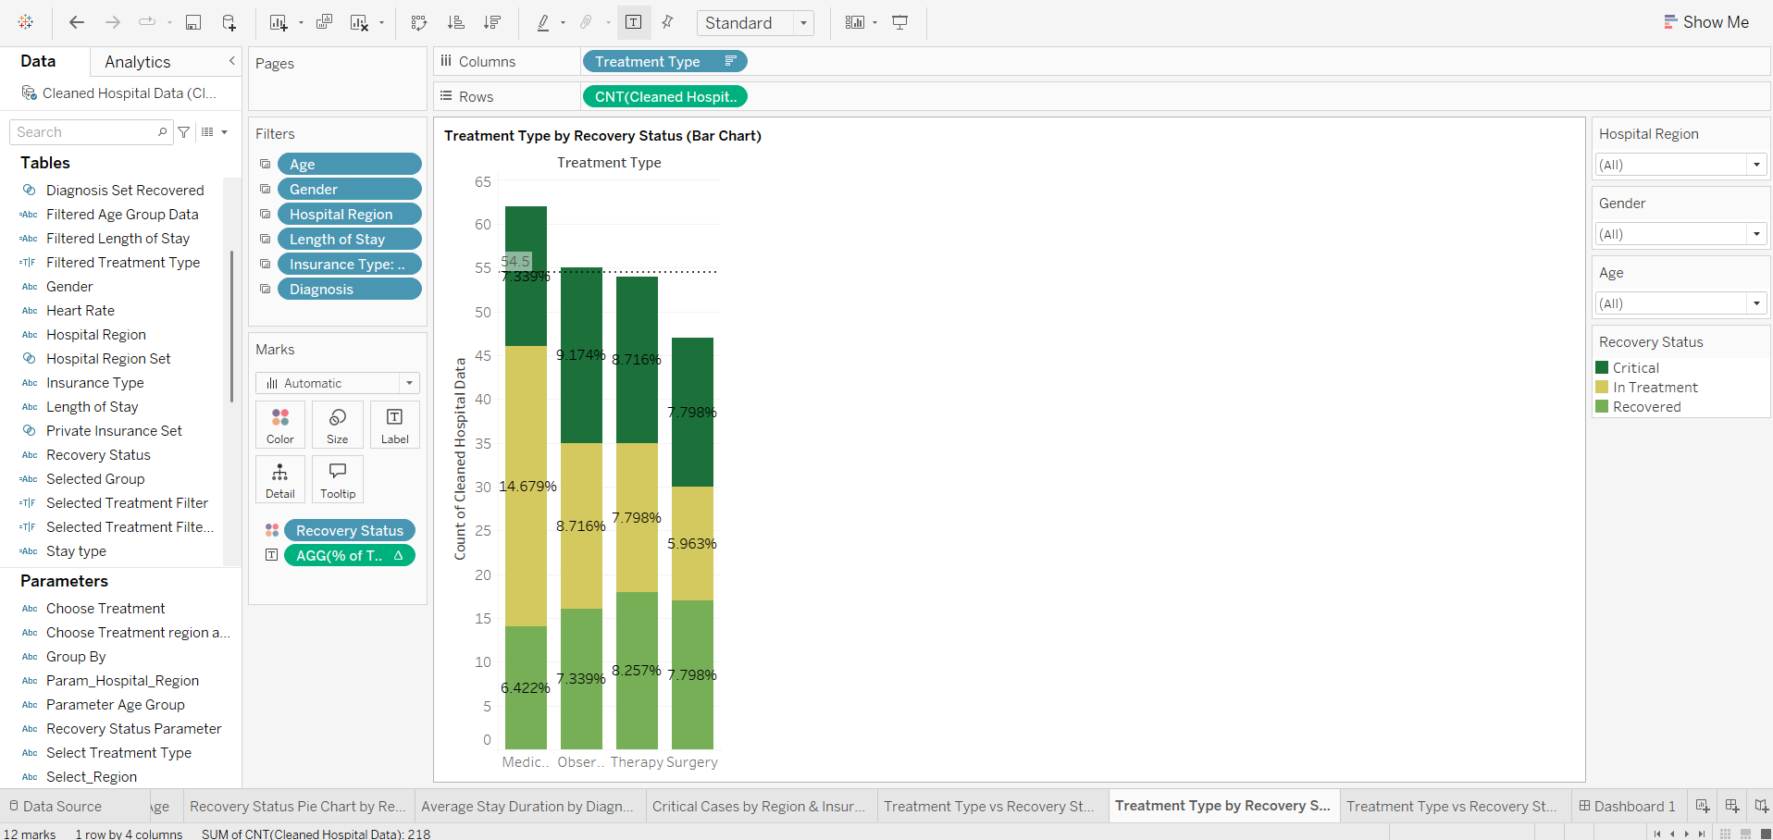

Slide 5
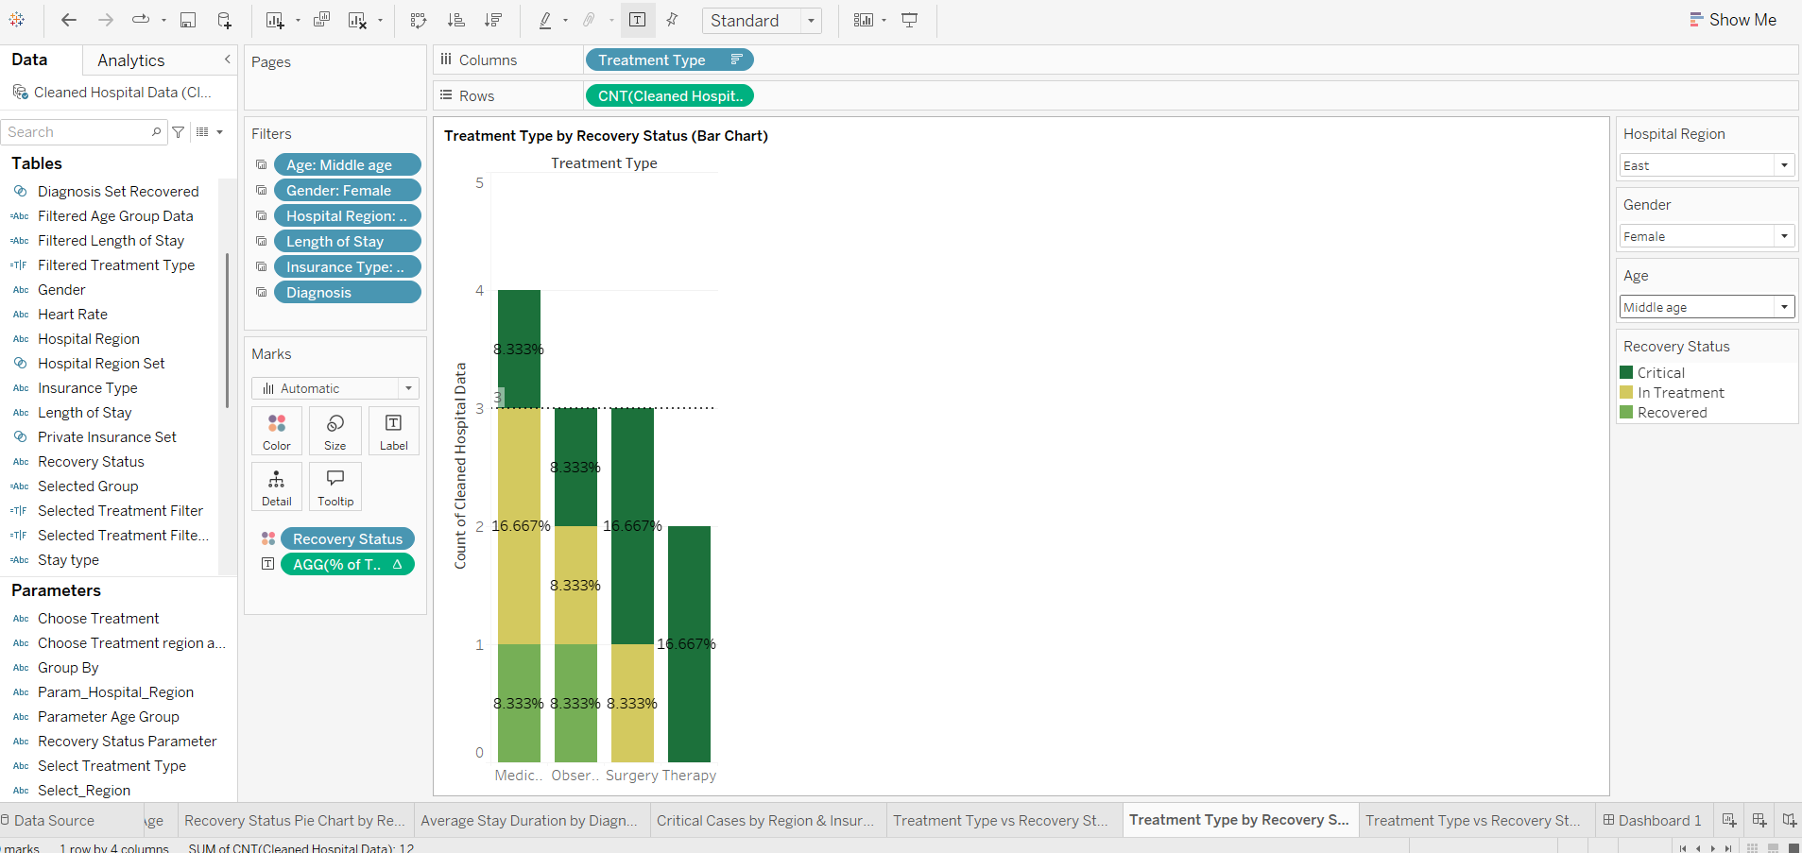

Slide 6
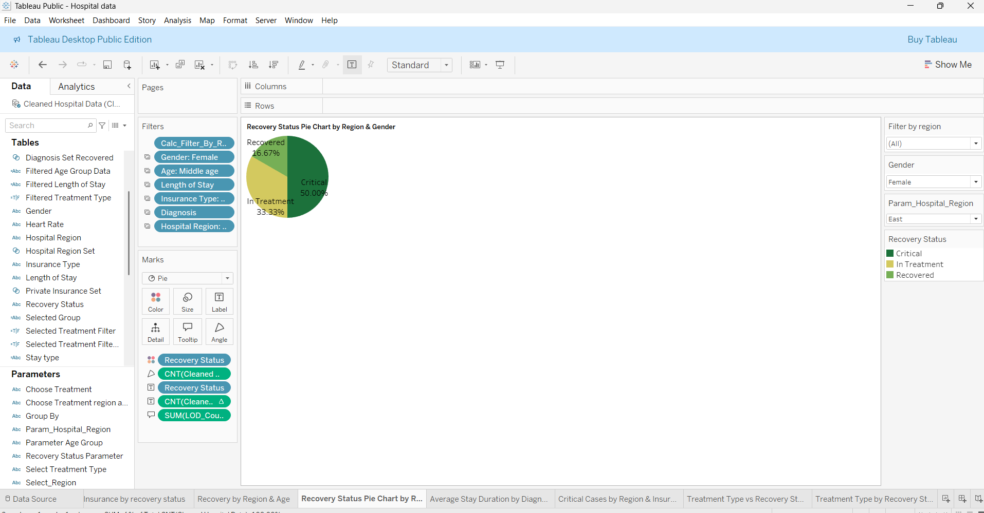

Slide 7
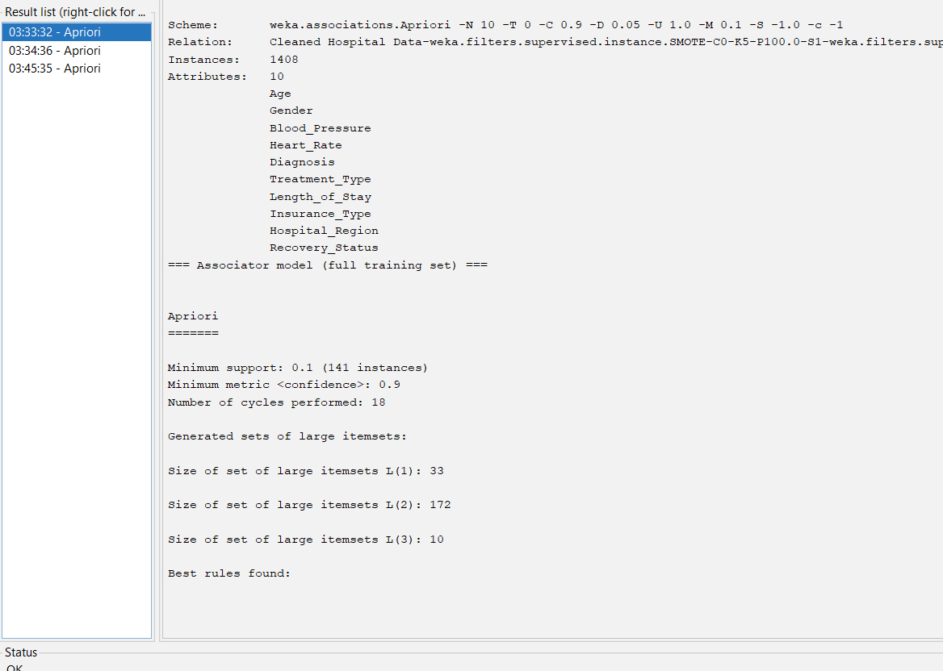
Applying Apriori in Weka
Used to uncover associations in categorical healthcare data
Settings used:
Support: 0.1 (85/850)
Confidence: 0.9
Top 10 rules generated
18 iterations performed

Slide 8
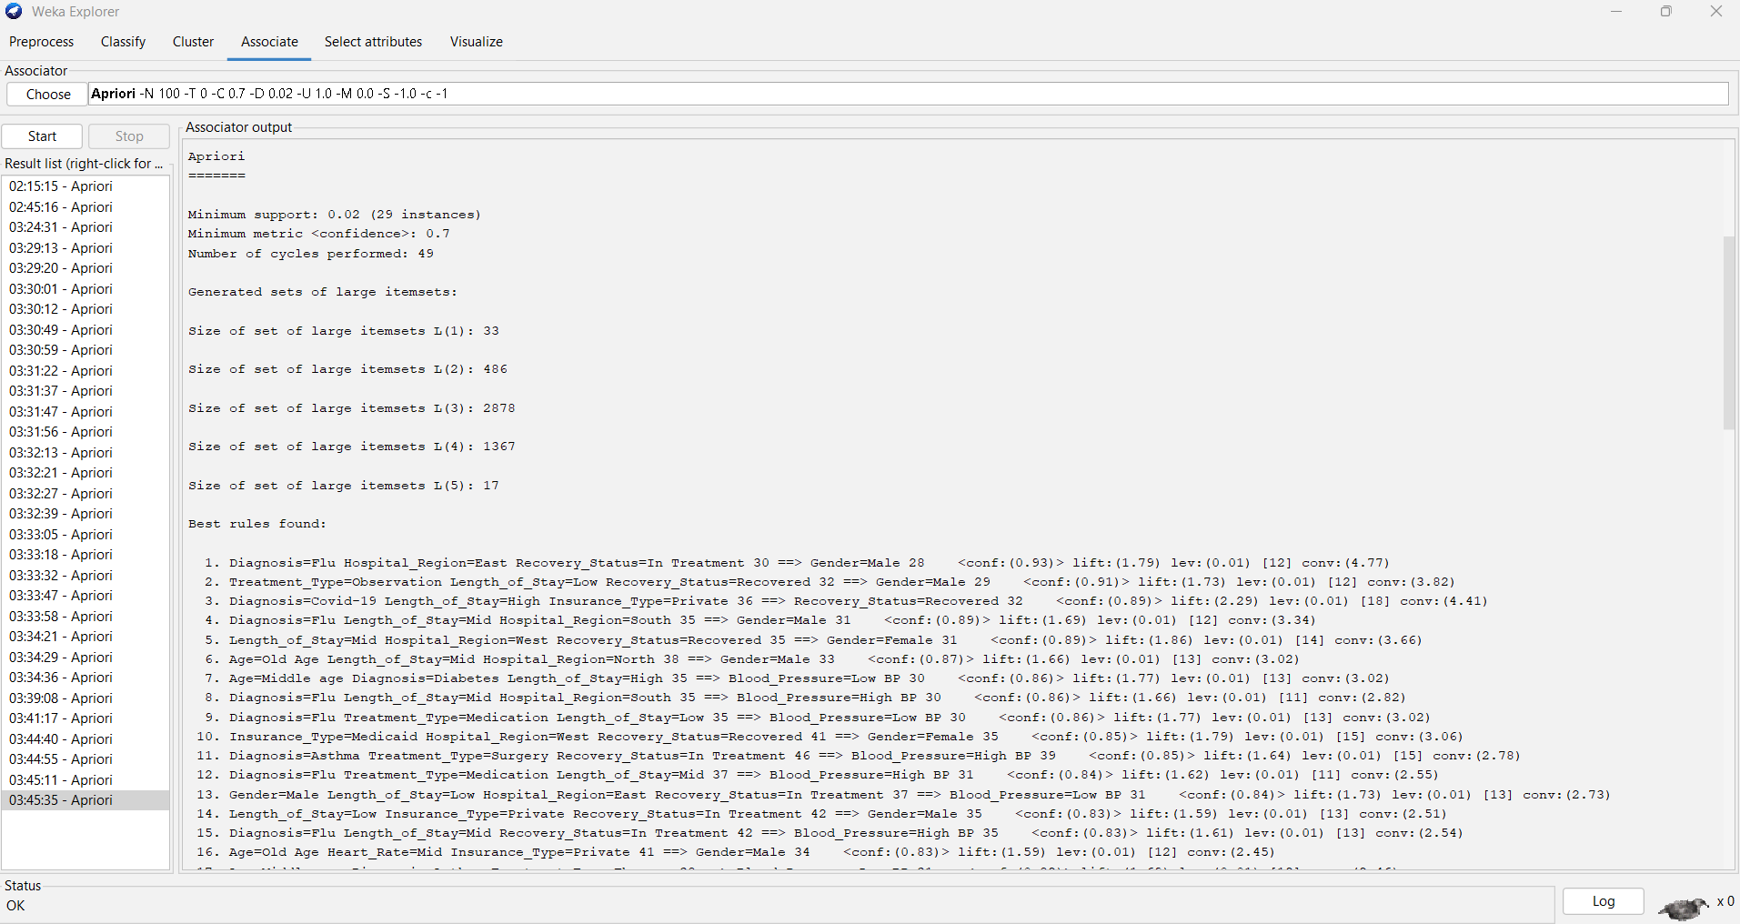
Configuration:
Algorithm: Apriori
Min Support: 0.02 (29 instances)
Min Confidence: 0.70
Data Set: Cleaned Hospital Data (with SMOTE applied)
Instances: 1,408
Attributes: 10
📊 Output Summary:
Cycles performed: 49
Large Itemsets:
L(1): 33
L(2): 486
L(3): 2878
L(4): 1367
L(5): 17
Top Association Rules:
If Diagnosis=Flu AND Region=East AND Recovery=In Treatment → Then Gender=Male (Confidence: 93%, Lift: 1.79)
If Diagnosis=Covid-19 AND Stay=High AND Insurance=Private → Then Recovery=Recovered (Confidence: 89%, Lift: 2.29)

Slide 9
Conclusions
Insights from Tableau Visualizations:
Middle-aged males with high BP and surgery had longer stays and higher recovery rates.
Therapy and observation were common in young patients but had varied recovery outcomes.
Recovery rates are higher in the North and East hospital regions.
Average length of stay is highest among older patients and those under surgical treatment.
Visual tools like filters, LODs, and parameters helped isolate critical patterns and validate the Weka results.

Slide 10
Conclusions
Insights from Weka (Apriori Algorithm):
Certain treatments are more frequently linked with specific diagnoses (e.g., Surgery → Recovery in Covid-19 cases).
Insurance Type impacts recovery — private and Medicare patients showed higher recovery success.
Age group and heart rate combinations reveal patterns in critical cases.

